Slide 1



Apache OpenWhisk
HPSC Final Project

Slide 2
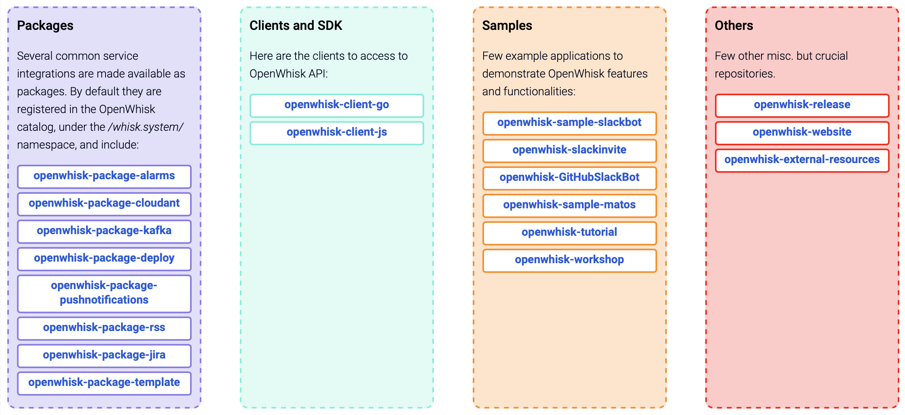
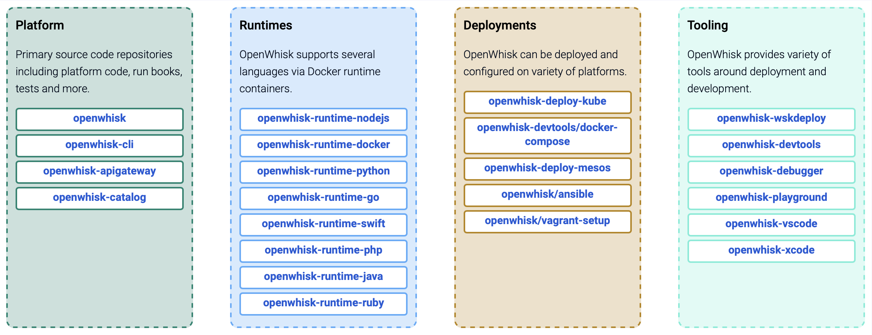
Apache OpenWhisk
z
A big project!

Slide 3
Scale-up the local deployments!
All serverless platforms provides some large-scale limits
AWS Lambda
IBM Cloud Functions
Concurrency limit = 1000
# of functions that can be running concurrently

Slide 4
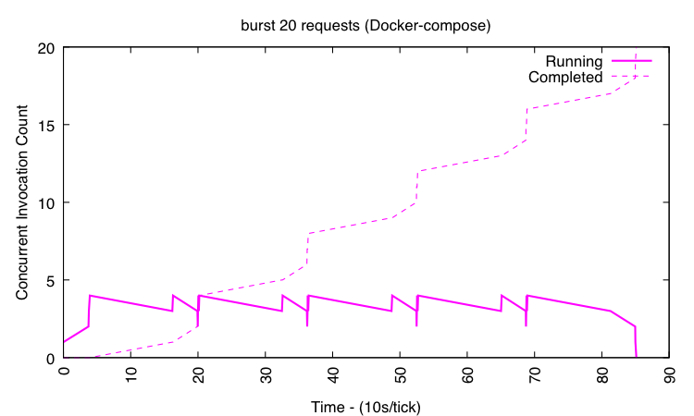
Apache OpenWhisk
Deployment (Docker-compose)
Concurrency = 4
Docker-Compose
Single Node
Simple
Non-production

Slide 5
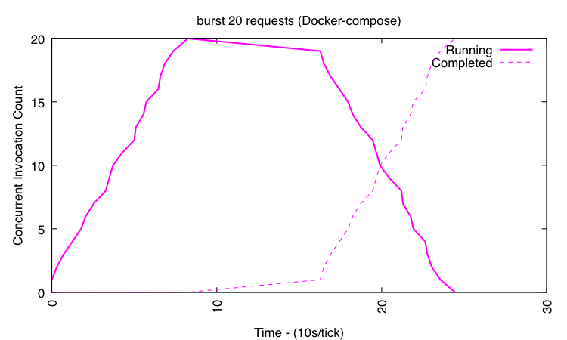
Apache OpenWhisk
Deployment (Docker-compose)
Containerpool
Default
1GB
New
200GB
z

Slide 6
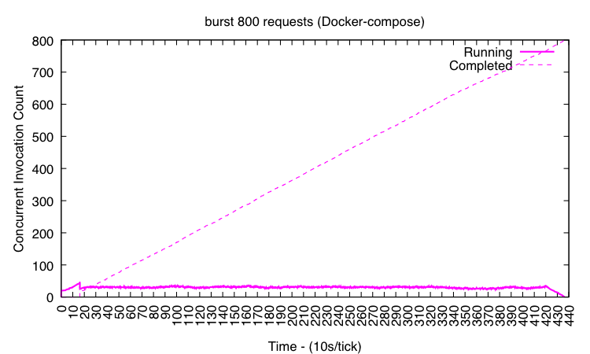

Slide 7
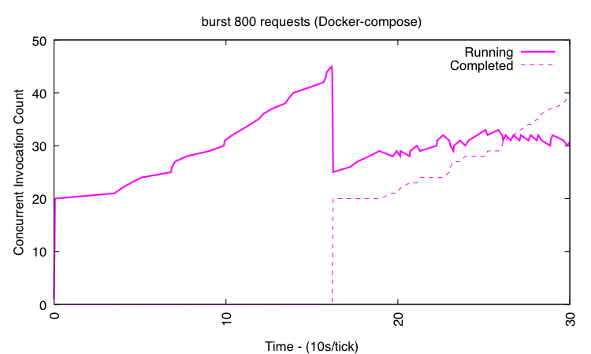
Apache OpenWhisk
Deployment (Docker-Compose)
Issues:
Slow Scale-up
Server down!

Slide 8
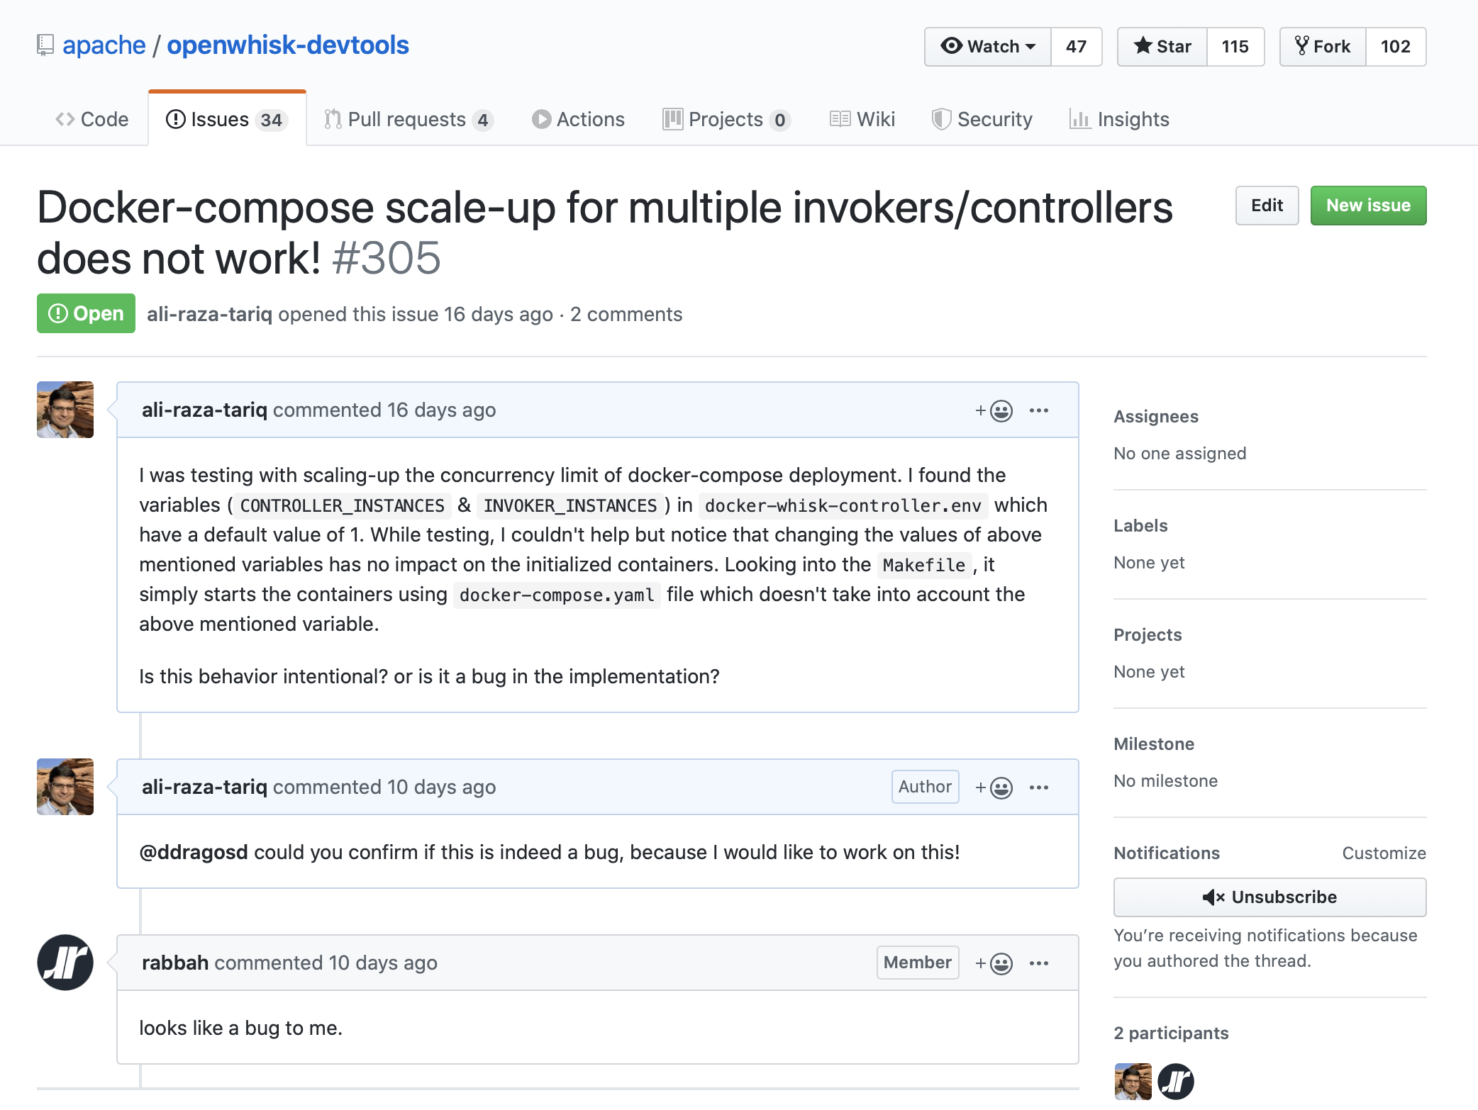
Implementation Bug!
Need more invokers/controllers
Configuration file not working!
Reply a little slow!

Slide 9
Apache OpenWhisk
Deployment (Docker-compose)
Concurrency = 8
Kubernetes
Multi Node
Complex
Production

Slide 10
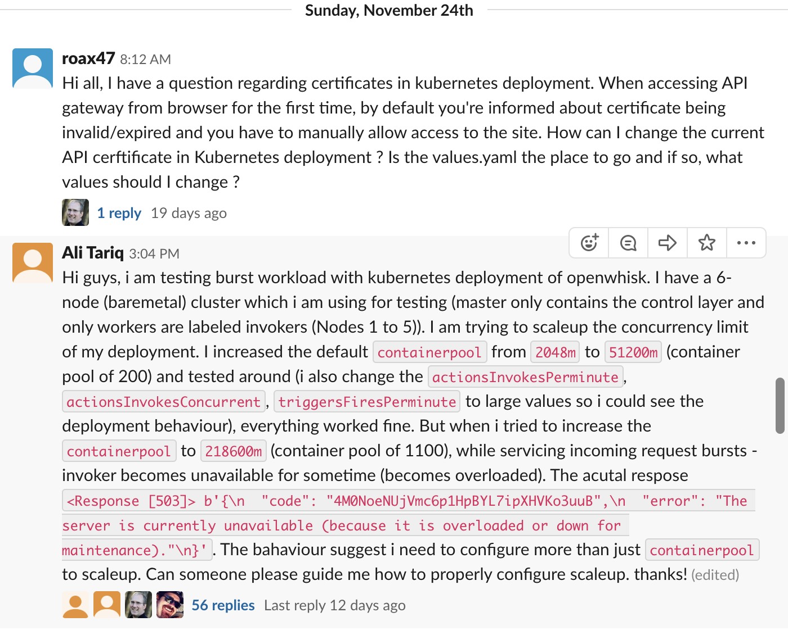
Apache OpenWhisk
Deployment (Kubernetes)
Complex
So Many configurations!
Slack to the rescue!

Slide 11
Debugging!
z

Slide 12
Debugging!
z

Slide 13
Debugging! - OpenWhisk is done! - Kubernetes Scheduler
z

Slide 14
Apache OpenWhisk
Deployment (Kubernetes)
Scale-up completed successfully

Slide 15
What did we achieve?
Workload completion time
From 440s to 18s
Server never down for maintenance
Fast scale-up

Slide 16
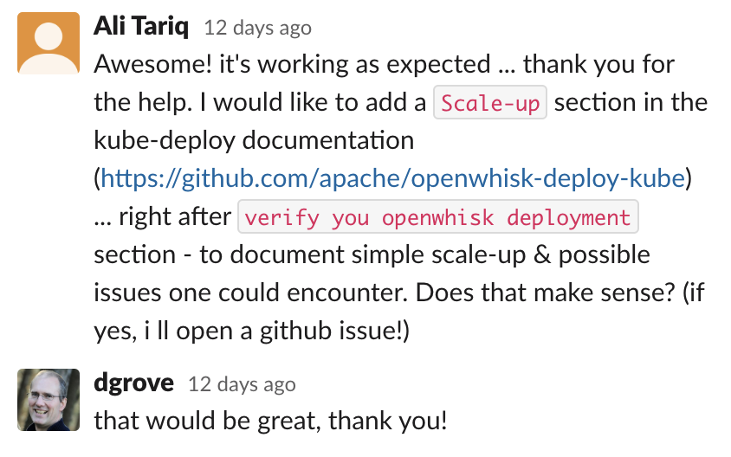
Apache OpenWhisk
Another contribution!

Slide 17
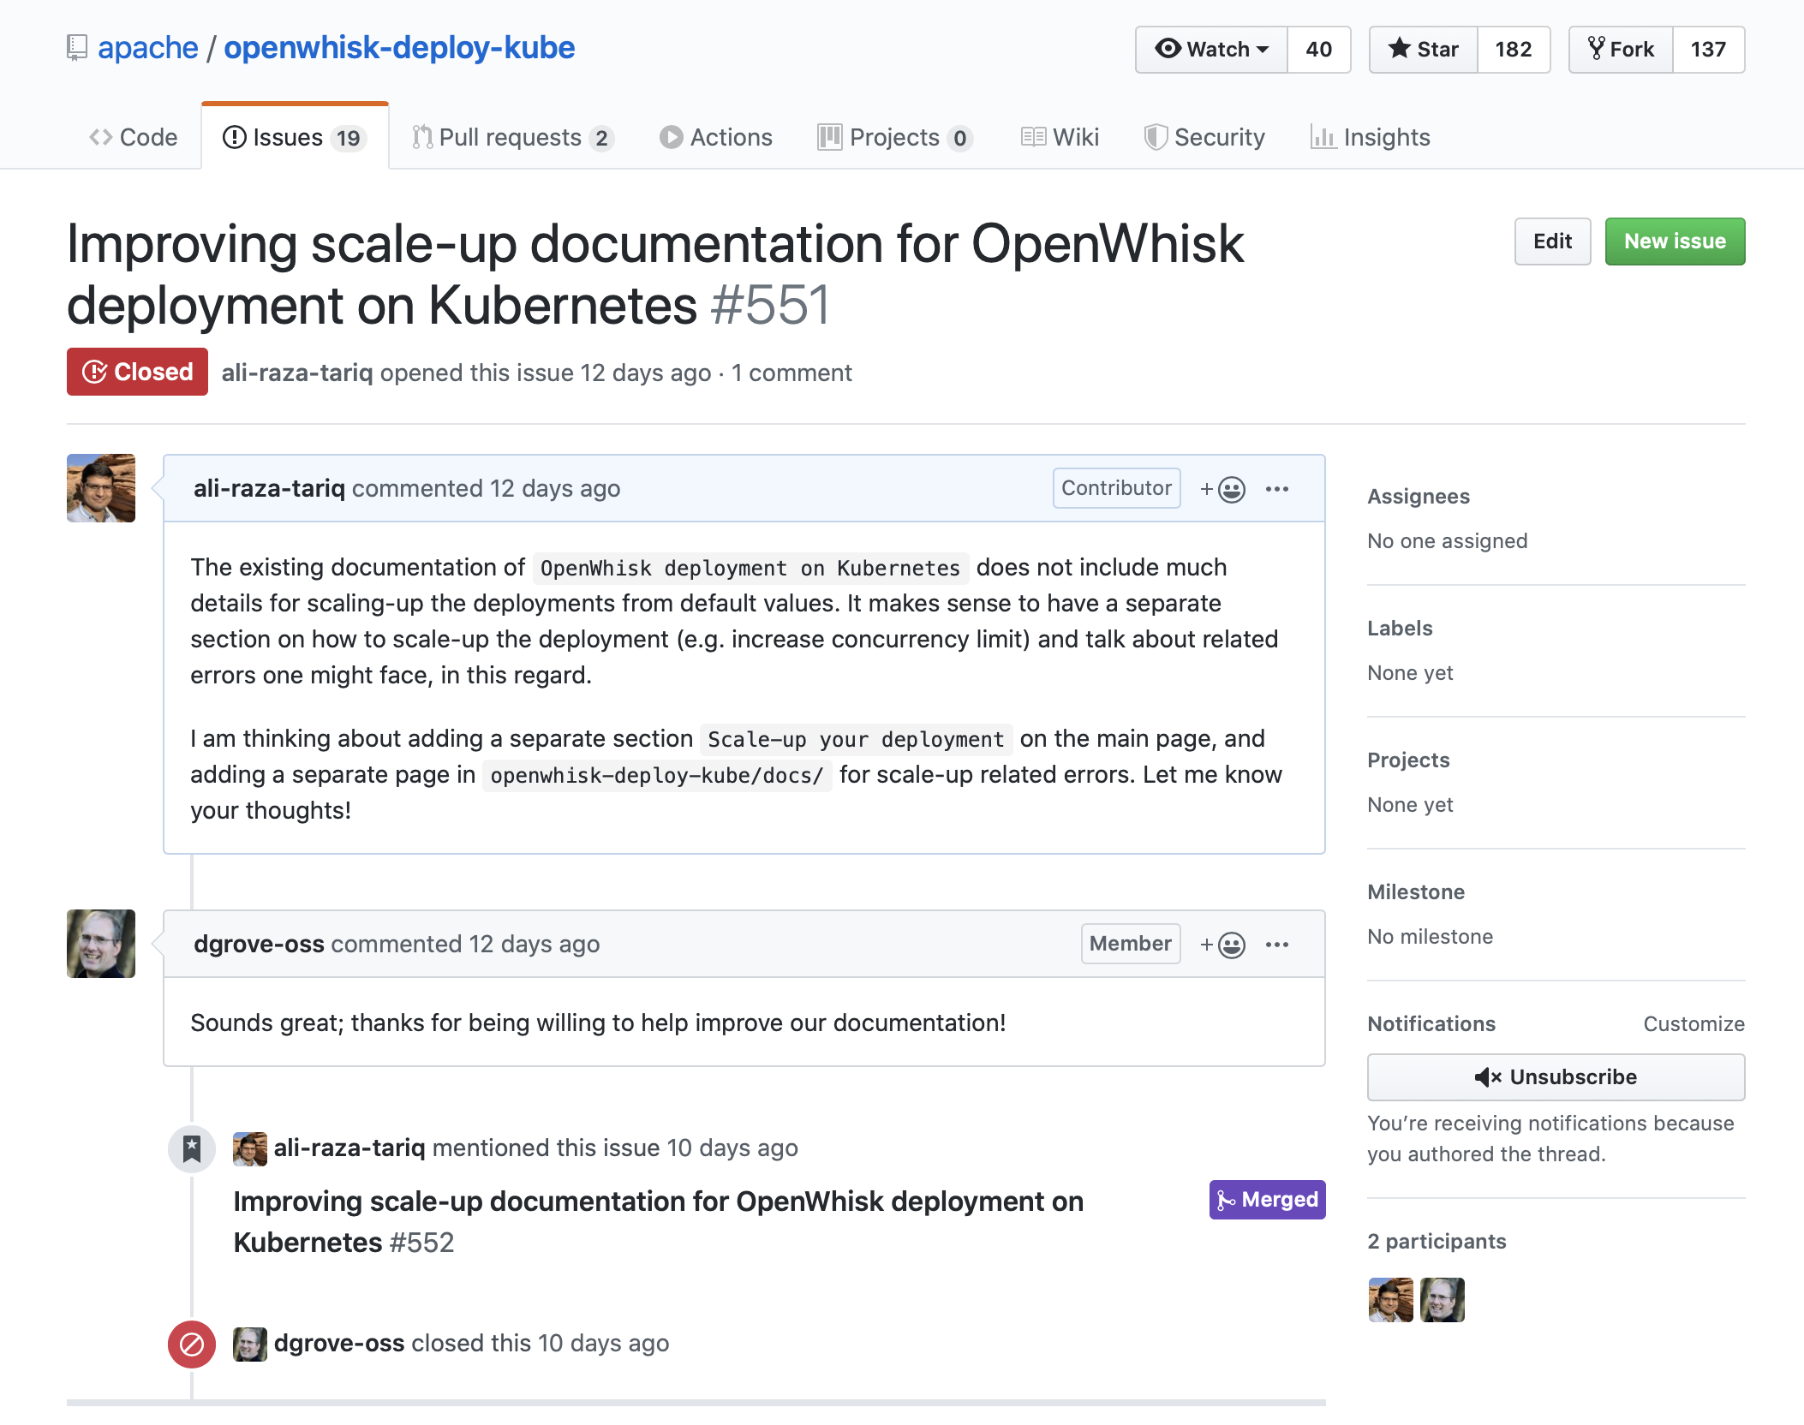

Slide 18
Thank you!
z

